Slide 1

SEN 101
Introduction to Computing and Application
Lecture 3: Data manipulation, computer architecture, machine instruction, and communication with other devices.
Ibrahim Abdullahi
Nile University of Nigeria, Abuja
Faculty of Natural and Applied Science Department of Software Engineering
© Adopted from UAI

Slide 2
Summary of last lecture
Information representation in computer and some operation on them.
Text
Images
Sound
Numeric
Memory of computer
Main memory
Mass storage (secondary storage)
Measure of memory capacity
2
©

Slide 3
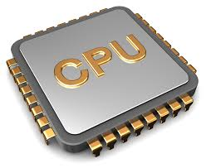
Computer architecture
A circuitry that control data manipulation inside a computer is called central processing unit (CPU) or merely refers to as processor of a computer.
Executes instructions of a computer program by performing;
Basic Arithmetic
Logical Operations
Control Operations
I/O Operations
As specified by the instructions…
Today’s processor
3
©

Slide 4
CPU basics
CPU
Arithmetic/logic
Control unit
Registers
Operation on data
Addition
Subtraction
Coordinating activities
Buffer cells within CPU
GPR
SPR
4
©

Slide 5
CPU basic
General Purpose registers: is a buffer for data manipulated by CPU
Holds input to the ALU circuitry.
Provide storage space for the result of that (ALU) unit.
The control unit transfer the data from main memory to GPR
Tell the ALU which registers hold the data
Activate the appropriate circuitry within the ALU, and
Inform the ALU which register should receive the result.
5
©

Slide 6
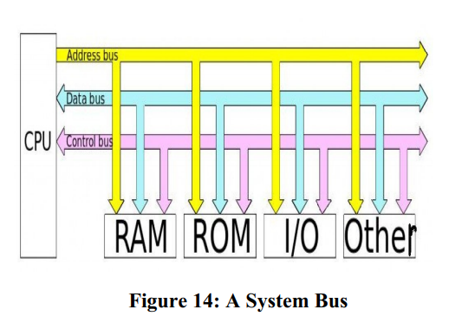
Computer Bus
Physical connections (cables, circuits etc.); hardware components that facilitate communication

Slide 7
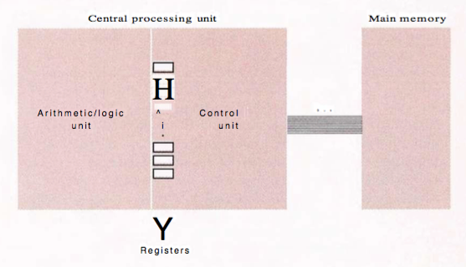
Bridge between CPU and main memory
Bus
©
7

Slide 8
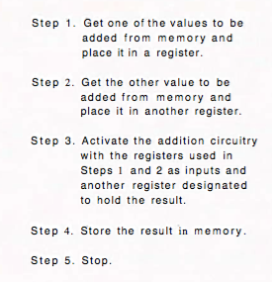
Addition operation on value stored in memory
Bus
8
©

Slide 9
Cache memory
A high speed memory located within the CPU that attempt to copy a portion of main memory that is of current interest. Data transfer that would be made between the register and main memory are made between the register and the cache memory. Any changes made to the cache are then transferred collectively to the main memory at a more opportune time.
9
©

Slide 10
Stored-program concept
Early computers generation everyone thought of programs and data as different entities:
Data were stored in memory
Programs were part of the CPU
The idea of storing a computer’s program in its main memory is called the stored-program concept
10
© UAI

Slide 11
Machine language
To apply the stored-program concept, CPUs are designed to recognize instructions encoded as bit patterns. The collection of instruction expressed in this coding system is called machine language. An instruction expressed in this language is called machine-level instruction or, more commonly, a machine instruction
11
© UAI

Slide 12
Data transfer instructions
Machine instructions can be categorized into three groupings: data transfer, ALU, and control.
Data transfer instructions that request the movement of data from one location to another.
Terms used when referring to the transfer of data from the CPU and main memory. A request to fill the GPR with the content of main memory cell is referred to as a LOAD instruction. A request to transfer the content of the register to main memory is called STORE instruction.
An important instruction within data transfer is called I/O instruction for communicating with devices outside the CPU.
12
© UAI

Slide 13
ALU instructions
Consist of instructions that tell the control unit to request an activity within the ALU.
Operation of ALU
Addition and Subtraction
Performing Boolean operations (AND, OR and XOR)
13
© UAI

Slide 14
Control instructions
Consist of instructions that direct the execution of a program rather than the data manipulation. Step 3 in next slide falls into this category. The instruction term used in this section are JUMP (or BRANCH) instructions used to direct the CPU to execute an instruction other than the next one in the list.
14
© UAI

Slide 15
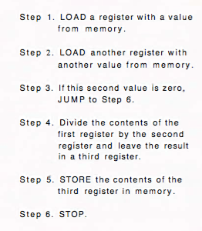
Dividing value stored in memory
15
© UAI

Slide 16
Communication with other device
Direct access memory
"Direct Memory Access." DMA is a method of transferring data from the computer's RAM to another part of the computer without processing it using the CPU. ...
For example, a sound card may need to access data stored in the computer's RAM, but since it can process the data itself, it may use DMA to bypass the CPU.
Example, projector
Handshaking
A situation in which the peripheral device also send information to the computer
Example, printer
16
© UAI

Slide 17
communication media
Parallel communication
Data can be transmit via multiple path
Serial communication
Data transmission using single path
Communication rate
Depending on the medium (kb, mb, …)
17
© UAI

Slide 18
Summary
Computer architecture
The CPU basics
ALU
Control unit
Register unit
Machine instruction
Data transfer
ALU
Control
Communication with other devices
Direct access memory
Handshaking
Communication media
Parallel communication
Serial communication
Communication rates
18
© UAI

Slide 19
Glimpse of next class
OS
Types of OS
Type of computer software
Component of OS
Concept of process within a computer
19
© UAI

Slide 20
Question????
Thank you for coming.
20
© UAI

